Slide 1

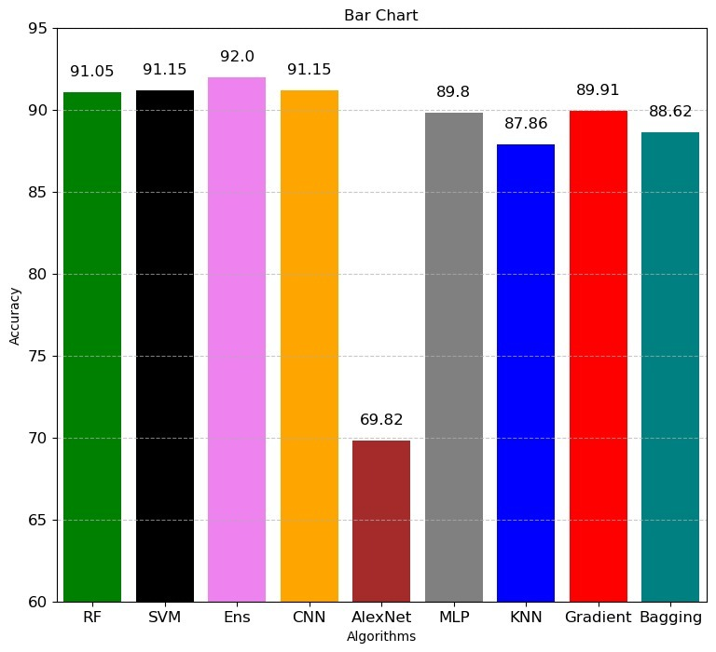
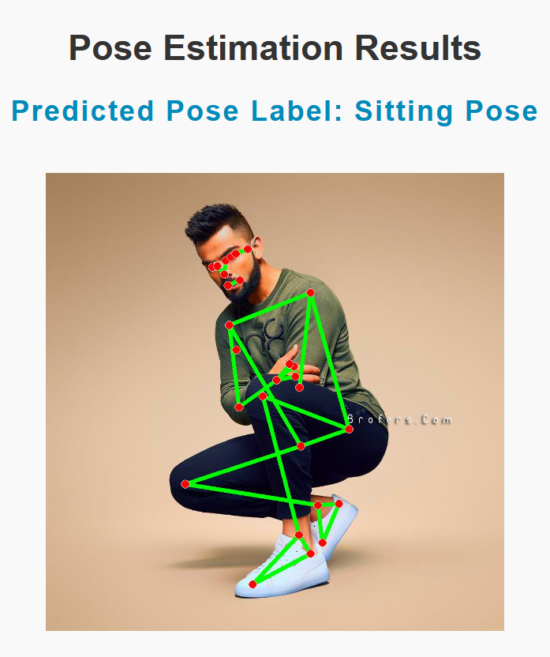
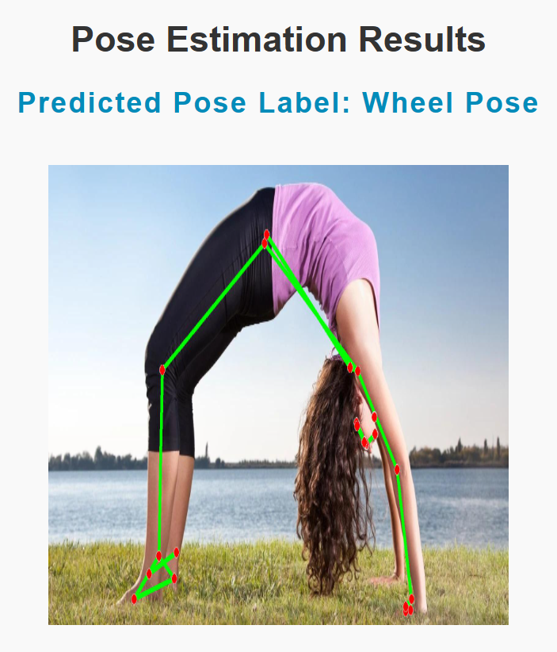
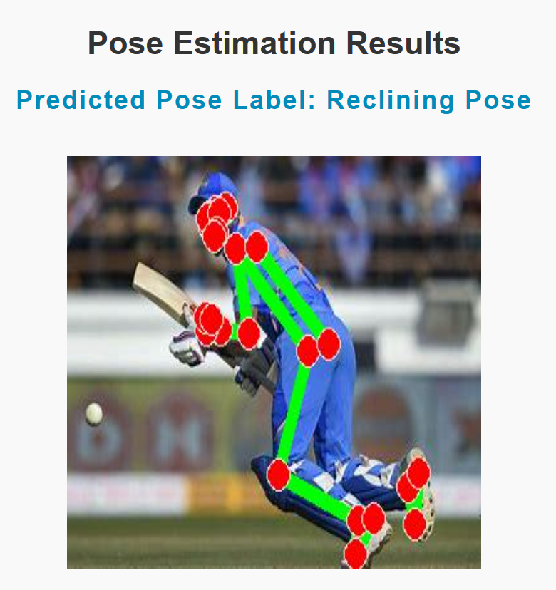
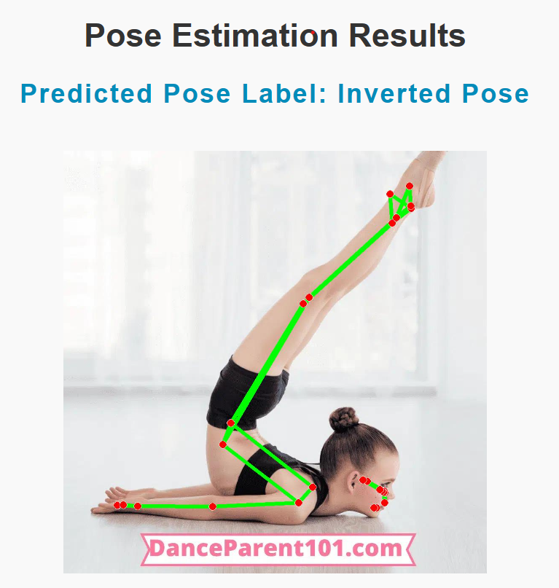
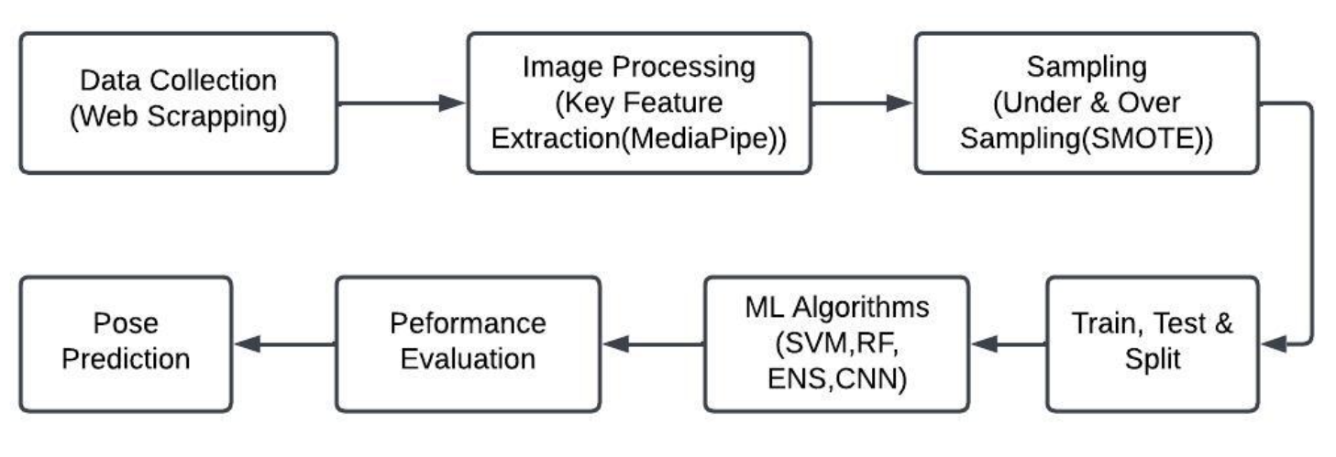
Human Pose Detection for Single Person using Machine Learning and Deep Learning Models
Harshitha Polsani, Venkata Ramya Vardineni, Anusha Yarrasani,
Dr. ABM Rezbaul Isalm
Department of Computer Science
COLLEGE OF SCIENCE & ENGINEERING TECHNOLOGY
SAM HOUSTON STATE UNIVERSITY
MEMBER THE TEXAS STATE UNIVERSITY SYSTEM
Introduction
Proposed Method
Experimental Results
Conclusions
Human pose detection is a computer vision technique used to detect and identify human joints or key points in images.
It involves analyzing the spatial arrangement of various body parts, such as the head, arms, and legs, and estimating their relative positions.
Yoga - 82 dataset and 107 directories were merged, which are divided into six poses: sitting pose, standing pose, balancing pose, reclining pose, inverted pose, and wheel pose.
Data Collection :
After removing invalid file types and processing the photos with the Media pipe library, a thorough dataset of 6219 instances was obtained.
Data Preprocessing :
We utilized Media pipe to extract 33 important points from the photos, yielding landmark data with 133 characteristics, including the x, y, z, and visibility coordinates of 33 key points.
To address imbalance issues, undersampling of majority classes and oversampling of minority classes using SMOTE is done.
Data Training :
Trained the data with SVM, RF, KNN, Bagging Classifier, Gradient Booster with multiple base estimators, and ensemble. Also used deep learning-based techniques such as a Convolutional Neural Network (CNN) and MLP. Performed K- fold cross validation.
Real time UI :
Model has been implemented for real-time human pose detection, and a user interface has been developed.
Figure – 1: Overview of proposed method
Machine learning based human pose detection is proposed and validated.
Image should be fully visible to accurately extract the key points and detect the pose of the human.
Project highlights the potential of using human pose detection in various applications, including sports coaching, rehabilitation, and virtual reality.
Figure – 2: Obtained accuracy with different algorithms
Contributions
Selected References
For key points extraction Media Pipe library is used, which provides a set of pre-built models for several computer vision applications, including posture estimate.
Performed undersampling and oversampling for the landmark data derived from the dataset to address class imbalance issues.
To train the model on the data, various machine learning models such as SVM, RF, KNN, Bagging Classifier with different base estimators, and ensembles of these classifiers were used. In addition, to improve the accuracy of our model, we used deep learning-based methodologies such as CNN (AlexNet) and MLP.
“Yoga-82: A New Dataset for Fine-grained Classification of Human Poses”, Manisha Verma, Sudhakar Kumawat, Yuta Nakashima, Shanmuganathan Raman , in ARXIV, 2020.
“Yoga Pose Detection and Correction using Posenet and KNN”, Varsha Bhosale, Pranjal Nandeshwar, Abhishek Bale, Janmesh Sankhe, in IRJET, 2022.
“Yoga Pose Classification Using Deep Learning,” Shruti Kothari, Robert Chun, Katerina Potika, and Susmit Gaikwad.
Figure – 3: Experimental results

